Slide 1


How to Interpret Z_{DR} Shade Charts
Lindsey M. Richardson, W. David Zittel, Robert R. Lee, Jessica A. Schultz, Dan B. Frashier, Amy E. Daniel

Slide 2

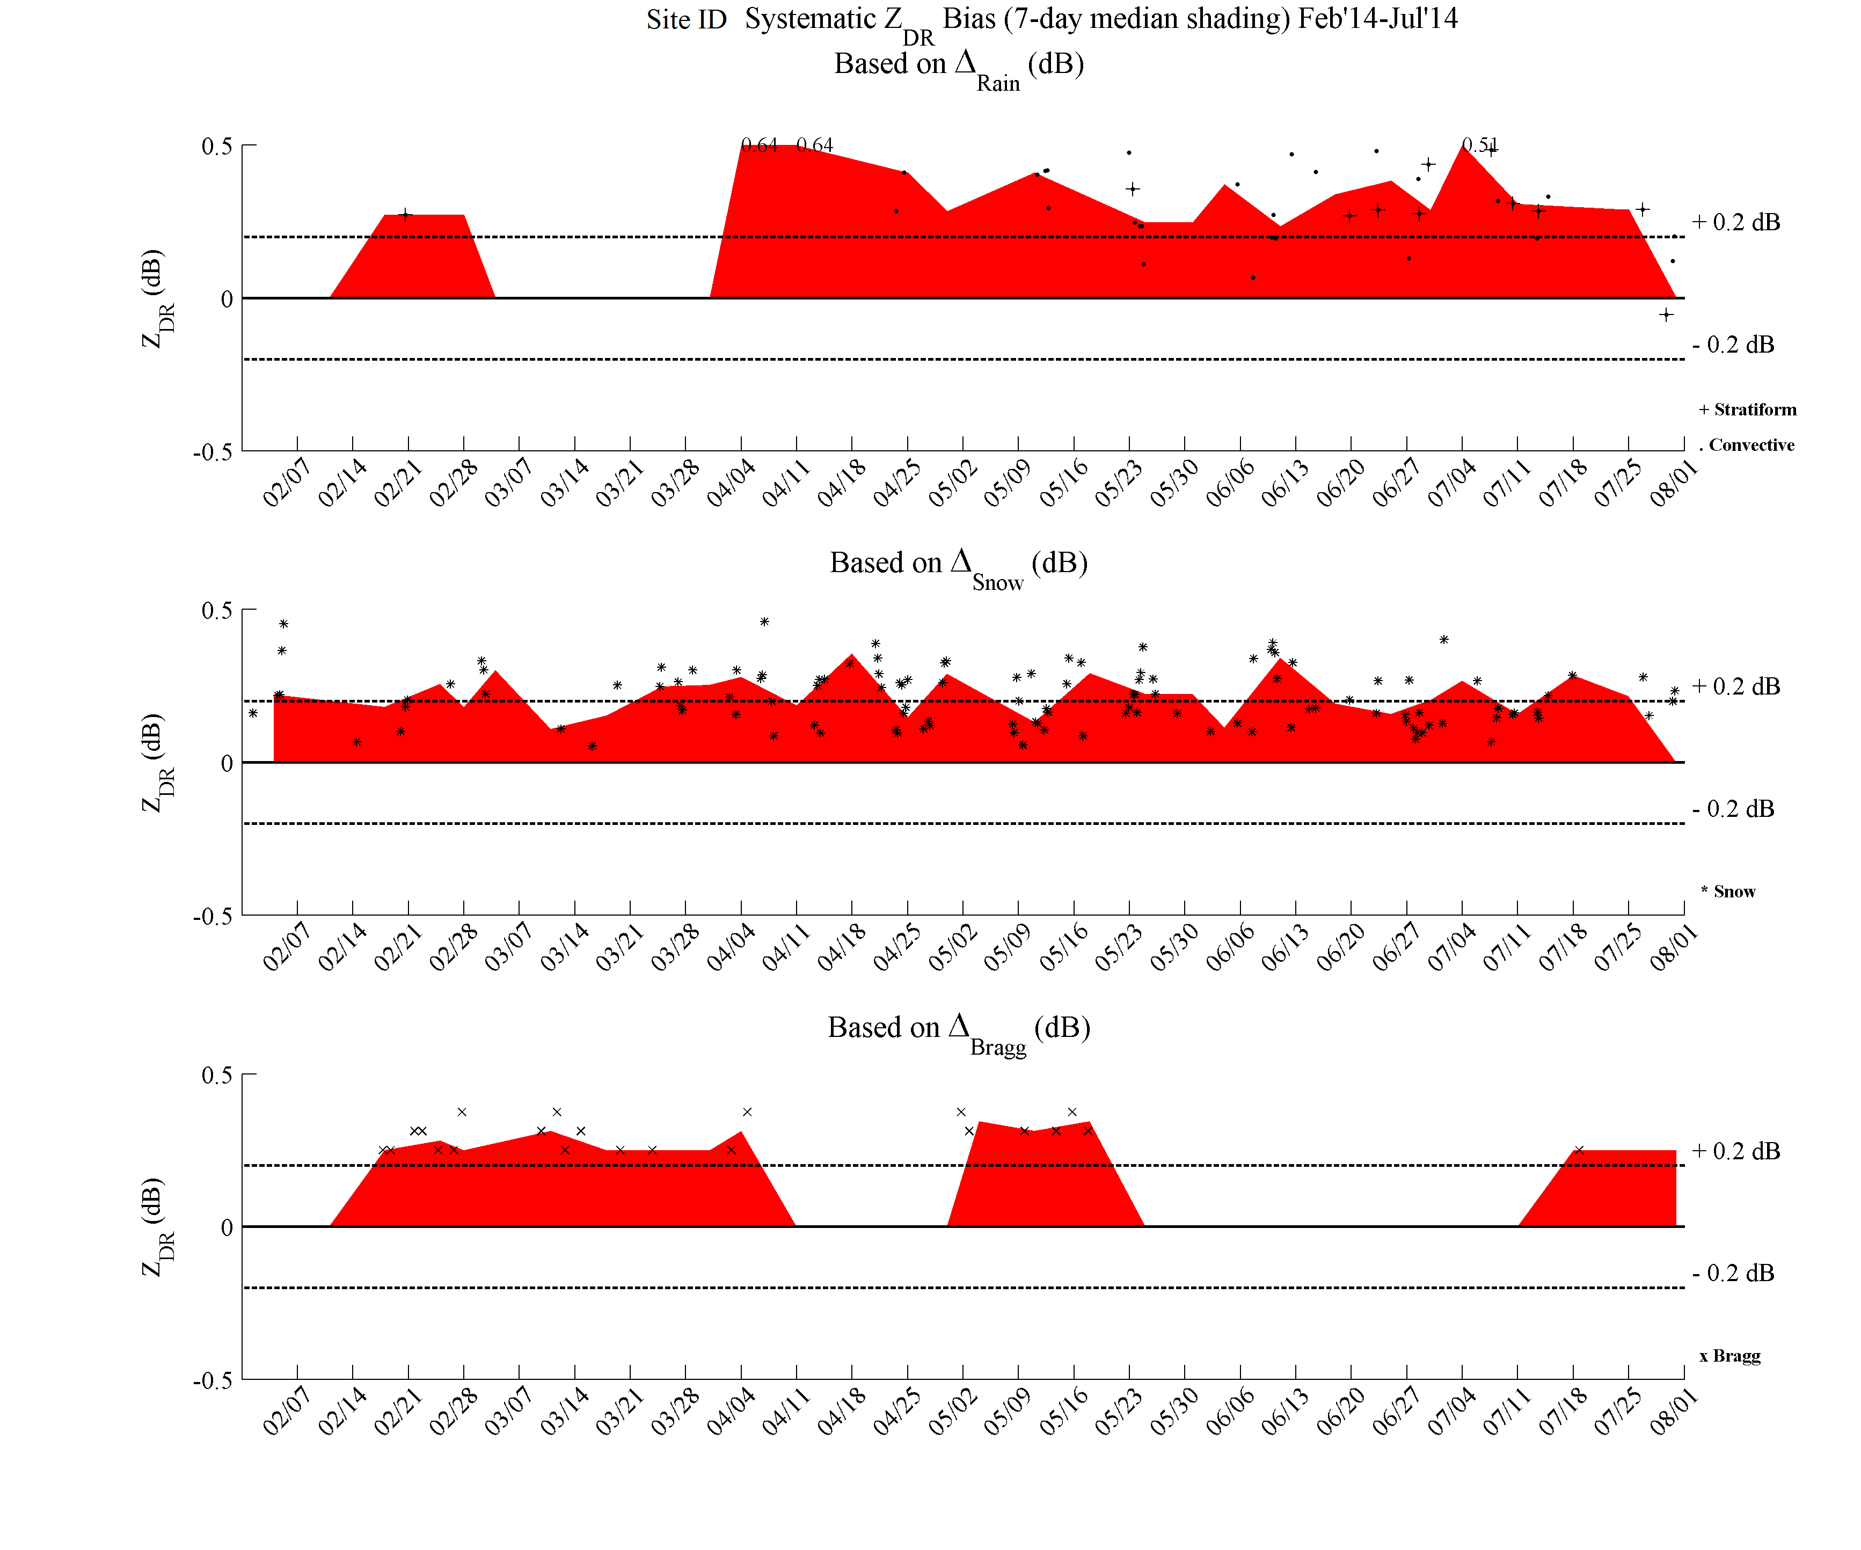
What’s a Shade Chart?
A way to monitor Z_{DR} bias from a single radar
  Information from most recent month and 6 months prior

Slide 3
What’s a Shade Chart? (Cont.)
Based on 3 independent external target methods:
  Light Rain (Average from an Event)
  Dry Aggregate Snow (Average from an Event)
  Bragg Scatter (Mode from an Event)
Event times and characteristics are different between the methods

Slide 4
Why do we care about Z_{DR} bias*?
Z_{DR} bias can have adverse affects on Quantitative Precipitation Estimation (QPE)
  A positive Z_{DR} bias results in underestimation
  A negative Z_{DR} bias results in overestimation
Z_{DR} affects other products as well
  Melting Layer Detection Algorithm (MLDA)
    Particularly “wet snow”
  Hydrometeor Classification Algorithm (HCA)
    Specific Z_{DR} thresholds for categories
* This is not the same as ZDRB

Slide 5
Why external targets?
External targets act as an estimation metric independent from the built-in hardware estimates
  Additional measurement to verify built-in hardware results
Methods work with operational scanning strategies and products

Slide 6
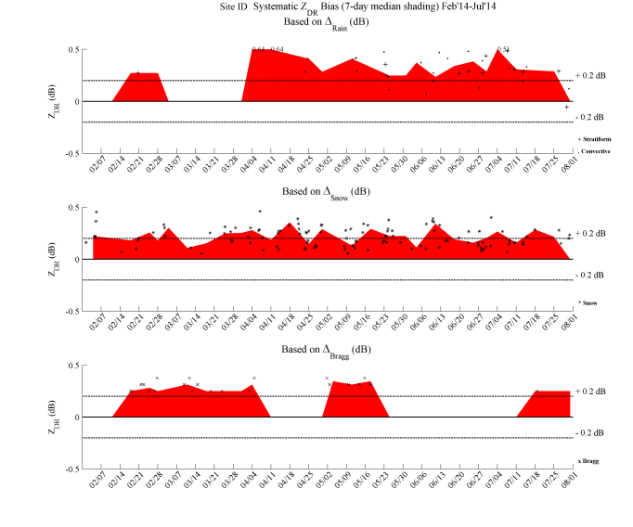
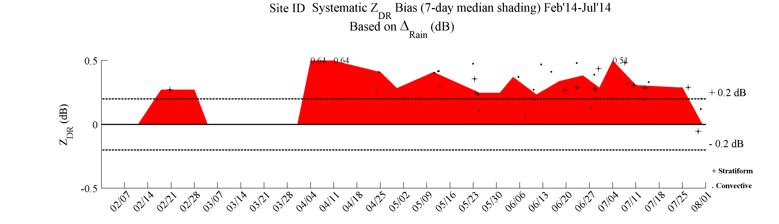
What’s on a Shade Chart?
Let’s focus on one of the methods for more details

Slide 7
Did you notice?
The dashed lines?
The black numbers at the top of the shading in places?
The gap in shading?
Each subplot contains information from an independent method?
The chart has a trend in time?
Let’s focus on a single subplot and explore these details

Slide 8
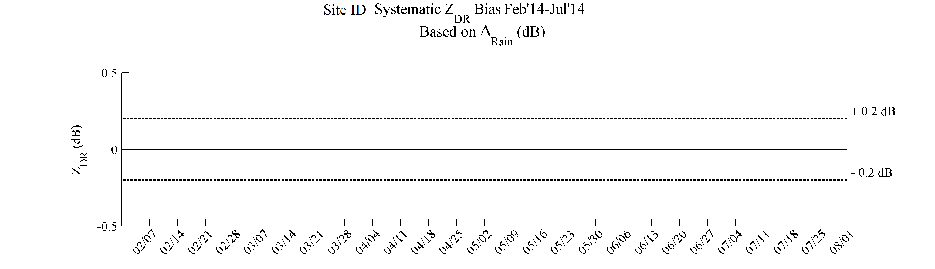
Layout of Each Subplot
Method
Tolerance
Limits
Time (6 Months Ago -----> Past Month)
Most Recent 6 months of Data

Slide 9
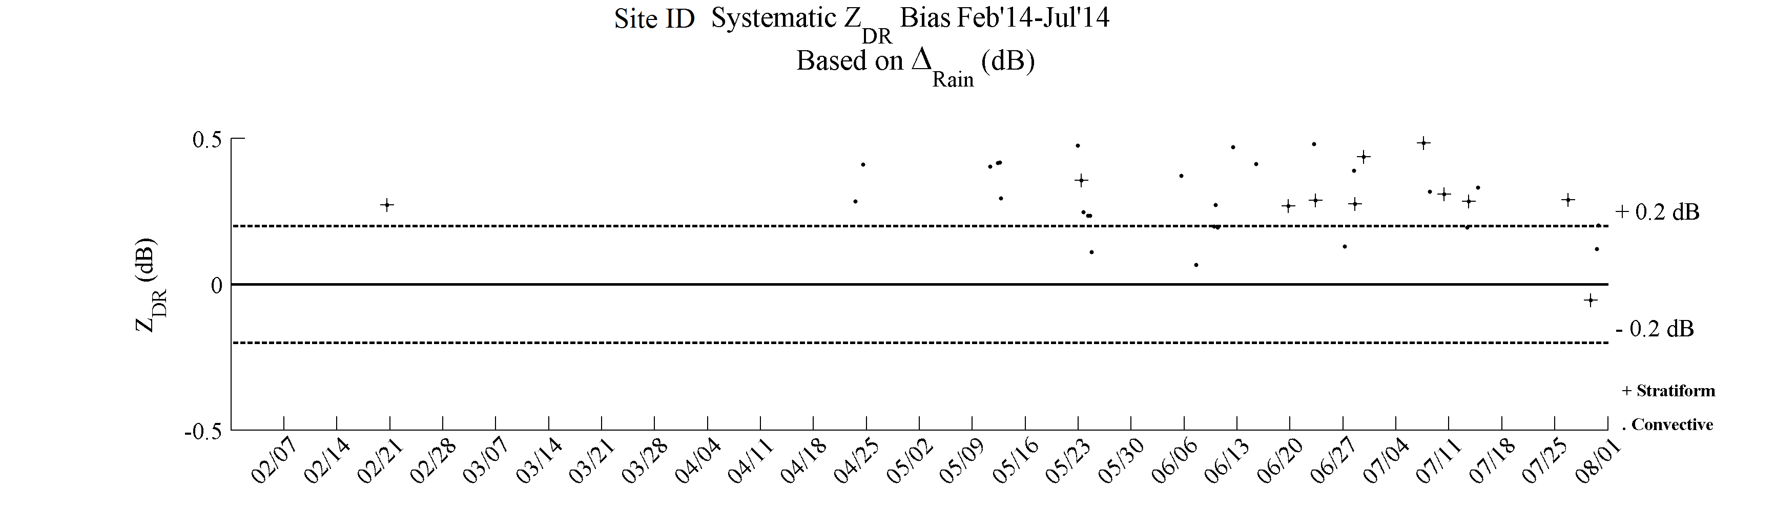
Z_{DR} Bias Estimates from Events
Main Title at top (on top subplot only)
Many, highly-varying scatter points
  Events may vary greatly from one to another
  Events are defined per method in later slides
Events are OK, but what if we took a 7-day median?
Note: + symbols and dots are grouped together as a set

Slide 10
7-Day Median Calculation
Median calculated from distinct 7-day periods each month
Solid lines are started from beginning of the month
  Days: 1-7, 8-14, 15-21, 22-28
Dashed lines are last 7 days of a month depending on the number of days in a given month
  Days: 23-29, 24-30, 25-31

Slide 11
7-Day Median Calculation Cont.
Shading vertex set at middle day of 7-day period from solid boxes
Vertex set to the last day (right edge) of dashed boxes

Slide 12
7-Day Median Shading
Long-term median trend shows a continuing bias
  Positive values are considered warm or high
  Negative values are considered cool or low
Sites are considered out-of-tolerance if the shading is regularly above (below) the dashed 0.2 dB (-0.2 dB) line

Slide 13
7-Day Median Shading Cont.
Median exceeds y-axis limits
Missing/NA
Medians beyond the y-axis limits are shown as a number near the top
No shading means the data is either missing, not available, or equals 0.0 dB exactly
Will interpolate if only missing one shade value between two valid points

Slide 14
7-Day Median Shading Cont.
Where are the scatter points?
Event scatter points outside of the y-axis limits (±0.5 dB) are not shown
Recall that median values from shading outside of the limits are represented by the black numbers at the top

Slide 15
7-Day Median Shading Cont.
Where are the scatter points?
Points could be associated with the end-of-the-month 7-day interval (the overlapping period), so previous point estimates carry over as seen here

Slide 16
Compare Trends from Multiple External Target Methods
Light Rain
Dry Snow
Bragg

Slide 17
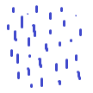
How do the methods differ?
Each method is independent and includes distinct caveats
Light Rain
Dry Snow
2 Methods Related to Precipitation:
  Light Rain (liquid precipitation)
  Dry Snow (frozen precipitation)
Melting Layer
Bragg Scattering
1 Method Related to Clear Air
  Bragg scattering associated with refractivity gradients
Turbulent Eddies
½ λ
λ
Click here to skip method details and jump to interpretation

Slide 18
Light Rain Method
Medians are calculated for six separate reflectivity (Z) categories
  Categories are inclusive and set as (in dBZ):
  A correction factor (in dBZ) based on climatology is subtracted from the median of each category:
  Subtraction correction can bias Z_{DR} low
19.0-20.5
21.0-22.5
23.0-24.5
25.0-26.5
27.0-28.5
29.0-30.5
0.23
0.27
0.32
0.38
0.46
0.55

Slide 19
Light Rain Method Cont.
3-6 hr Events (scatterpoints on chart)
  The average of the six categories within this time frame counts as an Event
  Can have multiple Events per day
Filters include:
  Range > 10km
  Height < 1km below the melting layer

Slide 20
Stratiform vs. “Convective”
Separately classify if an Event is more likely to be Stratiform Only or could contain some bigger drops from a more convective environment
  Larger drops can bias Z_{DR} high
  Estimates are NOT taken from the convective parts of a storm
Two tests:
  The amount of bins greater than or equal to 40 dBZ must be less than 40 bins
  80% of the bins must fall within 10-30 dBZ
    This 2nd test has filters of SNR > 20 dB, and RHO_{HV} > 0.98
    Tabulate bins between 10-30 dBZ and 30+ dBZ
Both tests must be valid to count an Event as Stratiform Only

Slide 21
Stratiform vs. Convective Cont.
Both Stratiform Only and Convective Events only consider values between 19.0-30.5 dBZ to estimate Z_{DR} bias
Stratiform Only cases are highlighted as a + in the Light Rain Events
  They are not considered as a separate data set in regards to shading

Slide 22
Dry Aggregate Snow Method
Estimated only on bins classified as Dry Snow by the Hydrometeor Classification Algorithm (HCA)
Extra filters:
  15 dBZ < Z < 25 dBZ
  Elevations > 1°
  SNR ≥ 20 dB,
  0.98 < RHO_{HV} < 1.0
  PHI < 100°
  Bins must be completely, but no more than 1 km above the melting layer
  Must have at least 500 Z_{DR} bins that pass filters per volume
  Standard deviation Z_{DR} < 0.5 dB

Slide 23
Dry Aggregate Snow Method Cont.
3-6 hr Events
  Average of the Z_{DR} values that pass the filters
  Subtract 0.2 dBZ (climatological value of dry snow) to get the Event bias
Can be estimated at the same time as a rain Event as long as dry aggregate snow is observed above the melting level
Dendrites and Platelets can bias Z_{DR} high
Subtraction correction can bias Z_{DR} low
Note: Aggregates are clumps of frozen precipitation (particularly ice crystals)

Slide 24
Bragg Scatter Method
Bragg distinguished by refractivity gradients generally caused by turbulent eddies
  Intrinsic Z_{DR} = 0.0 dB (no subtraction correction needed)
  Often found at the top of the Convective Boundary Layer
Filters:
  VCP 32 and 21 only currently (may change to allow more)
  10-80 km in range only
  Z < 10 dBZ
  |V| > 2 m/s
  W > 0 m/s
  SNR < 15 dB
  0.98 < ρ_{HV} < 1.05
  Elevations 2.5-4.5°

Slide 25
Bragg Scatter Method Cont.
Additional filters:
  Z at the 90th percentile ≤ -3 dBZ (precipitation filter)
  Need at least 10,000 bins that pass filters
  Inter-Quartile Range (IQR) < 0.9 (biota filter)
2 hr Events
  Currently only 17-19 UTC
  Will be potentially available every volume scan in Build 16 (12-volume running average of the Z_{DR} mode)

Slide 26
Bragg Scatter Method Cont.
Precipitation contamination can bias Z_{DR} high
Return from Bragg scattering has a weak signal, and if noise is comparable to the signal it could bias the estimate towards 0.0 dB
  Assuming the noise estimates are similar in both H and V channels

Slide 27
Method Availability
Light rain is less available during the cool season especially at northern sites
Dry aggregate snow can be found year round at most sites
Bragg scatter may give the most reliable estimate, but is less available due to stringent filters
  Also less available in the warm season due to biota contamination

Slide 28
Rely on More Than One Method When Possible!
When all 3 methods show a similar bias, there is high confidence in the indicated bias
All methods are not always available
  The trend should be realistic regardless
  Need at least a month of data to establish a baseline

Slide 29
Full-Chart Recap: Compare the Methods
ZDR is high (above and near the positive tolerance level) for the majority of the time in all three methods
Focus on most recent month
Compare with previous months for overall trend

Slide 30
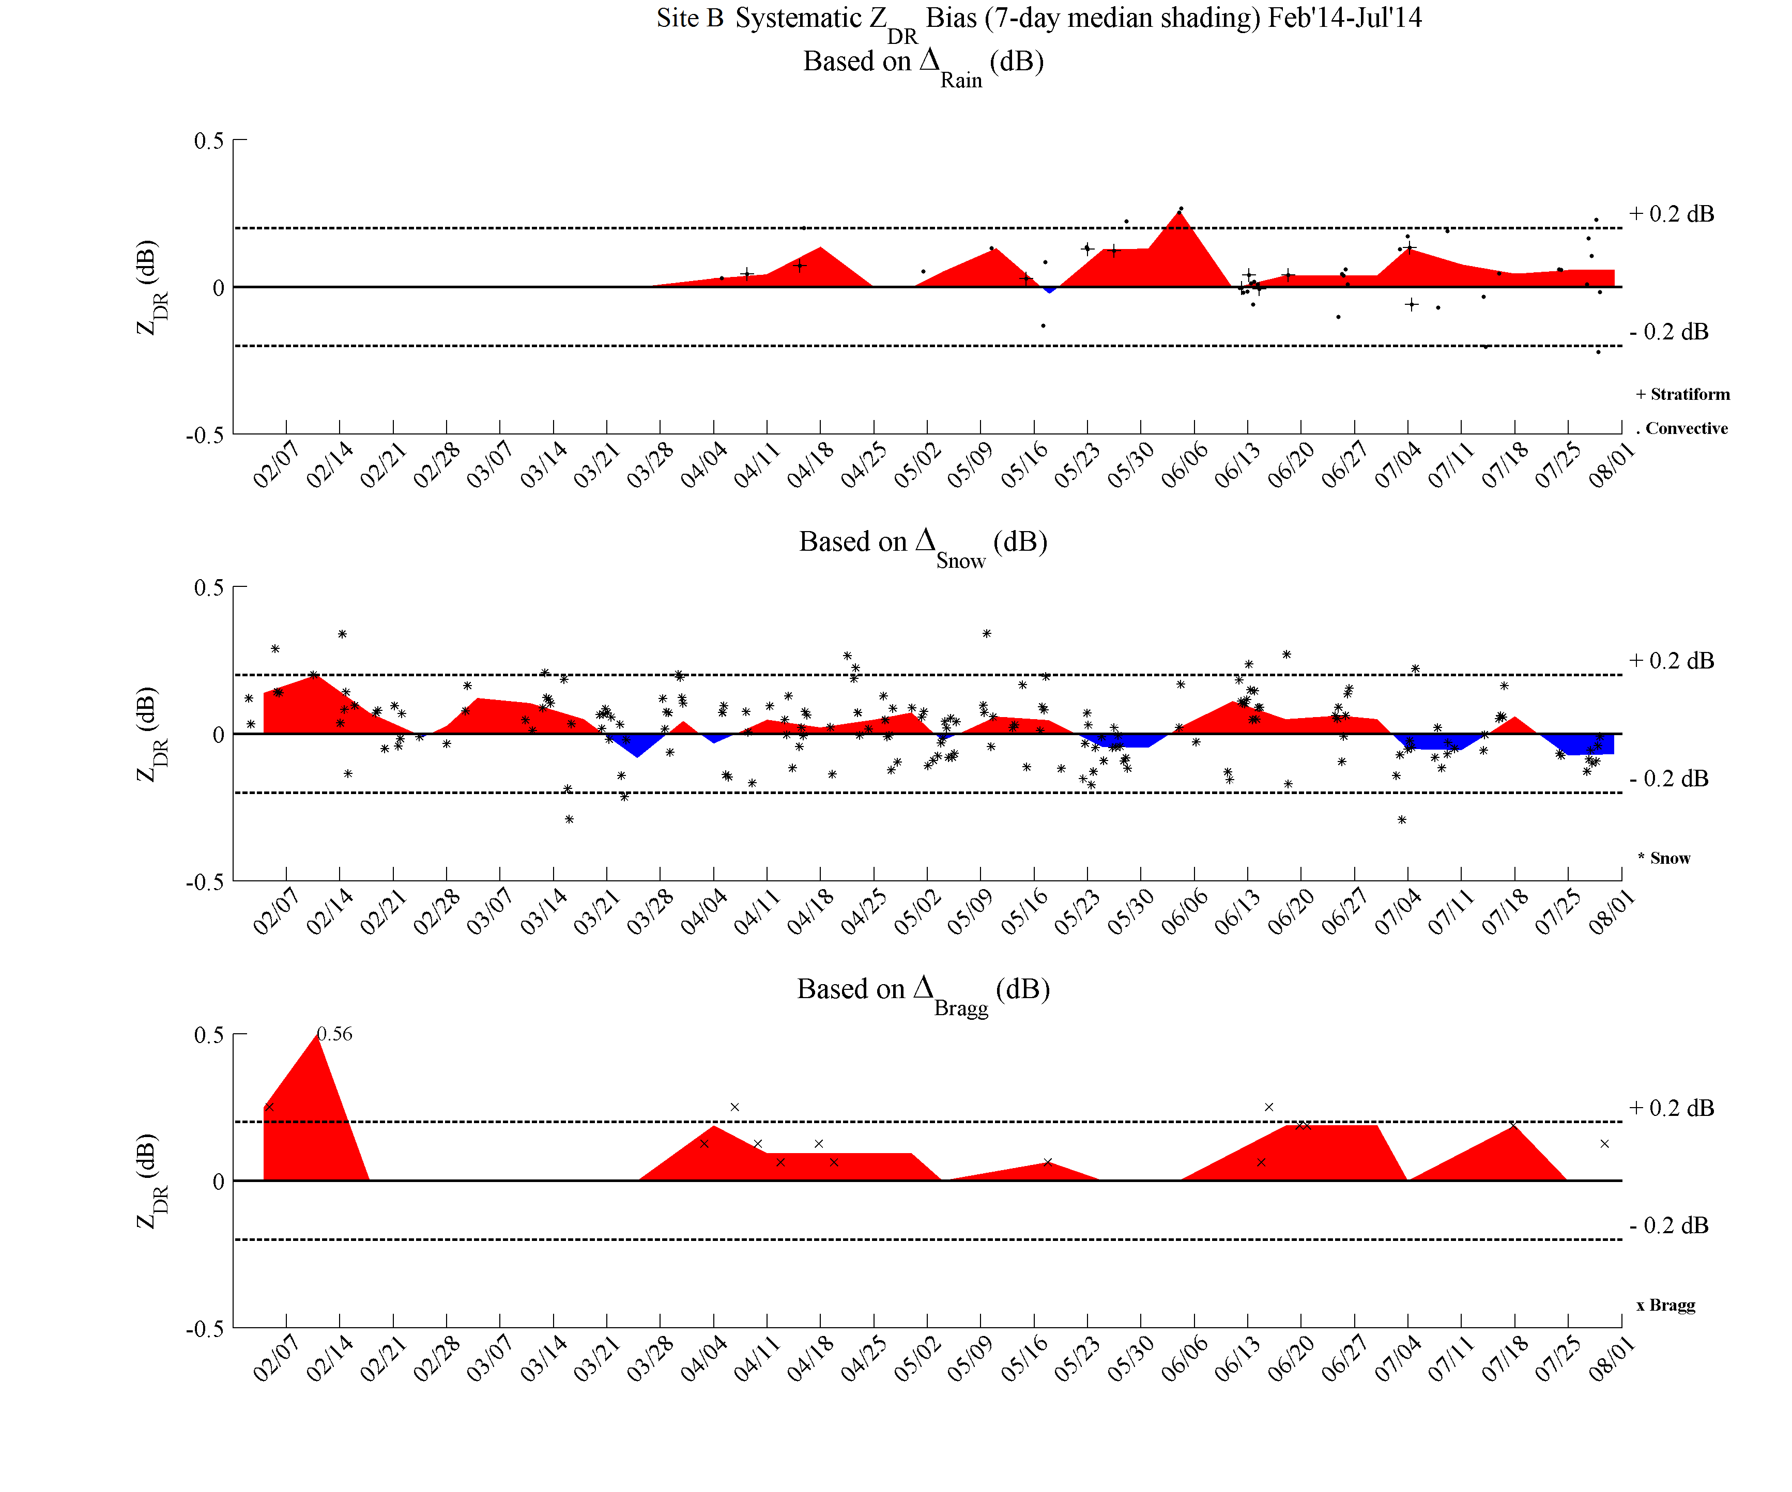
Shade Interpretation: “Good” Site
In Tolerance
Close to zero and within tolerance limits for all methods (especially the last month)

Slide 31
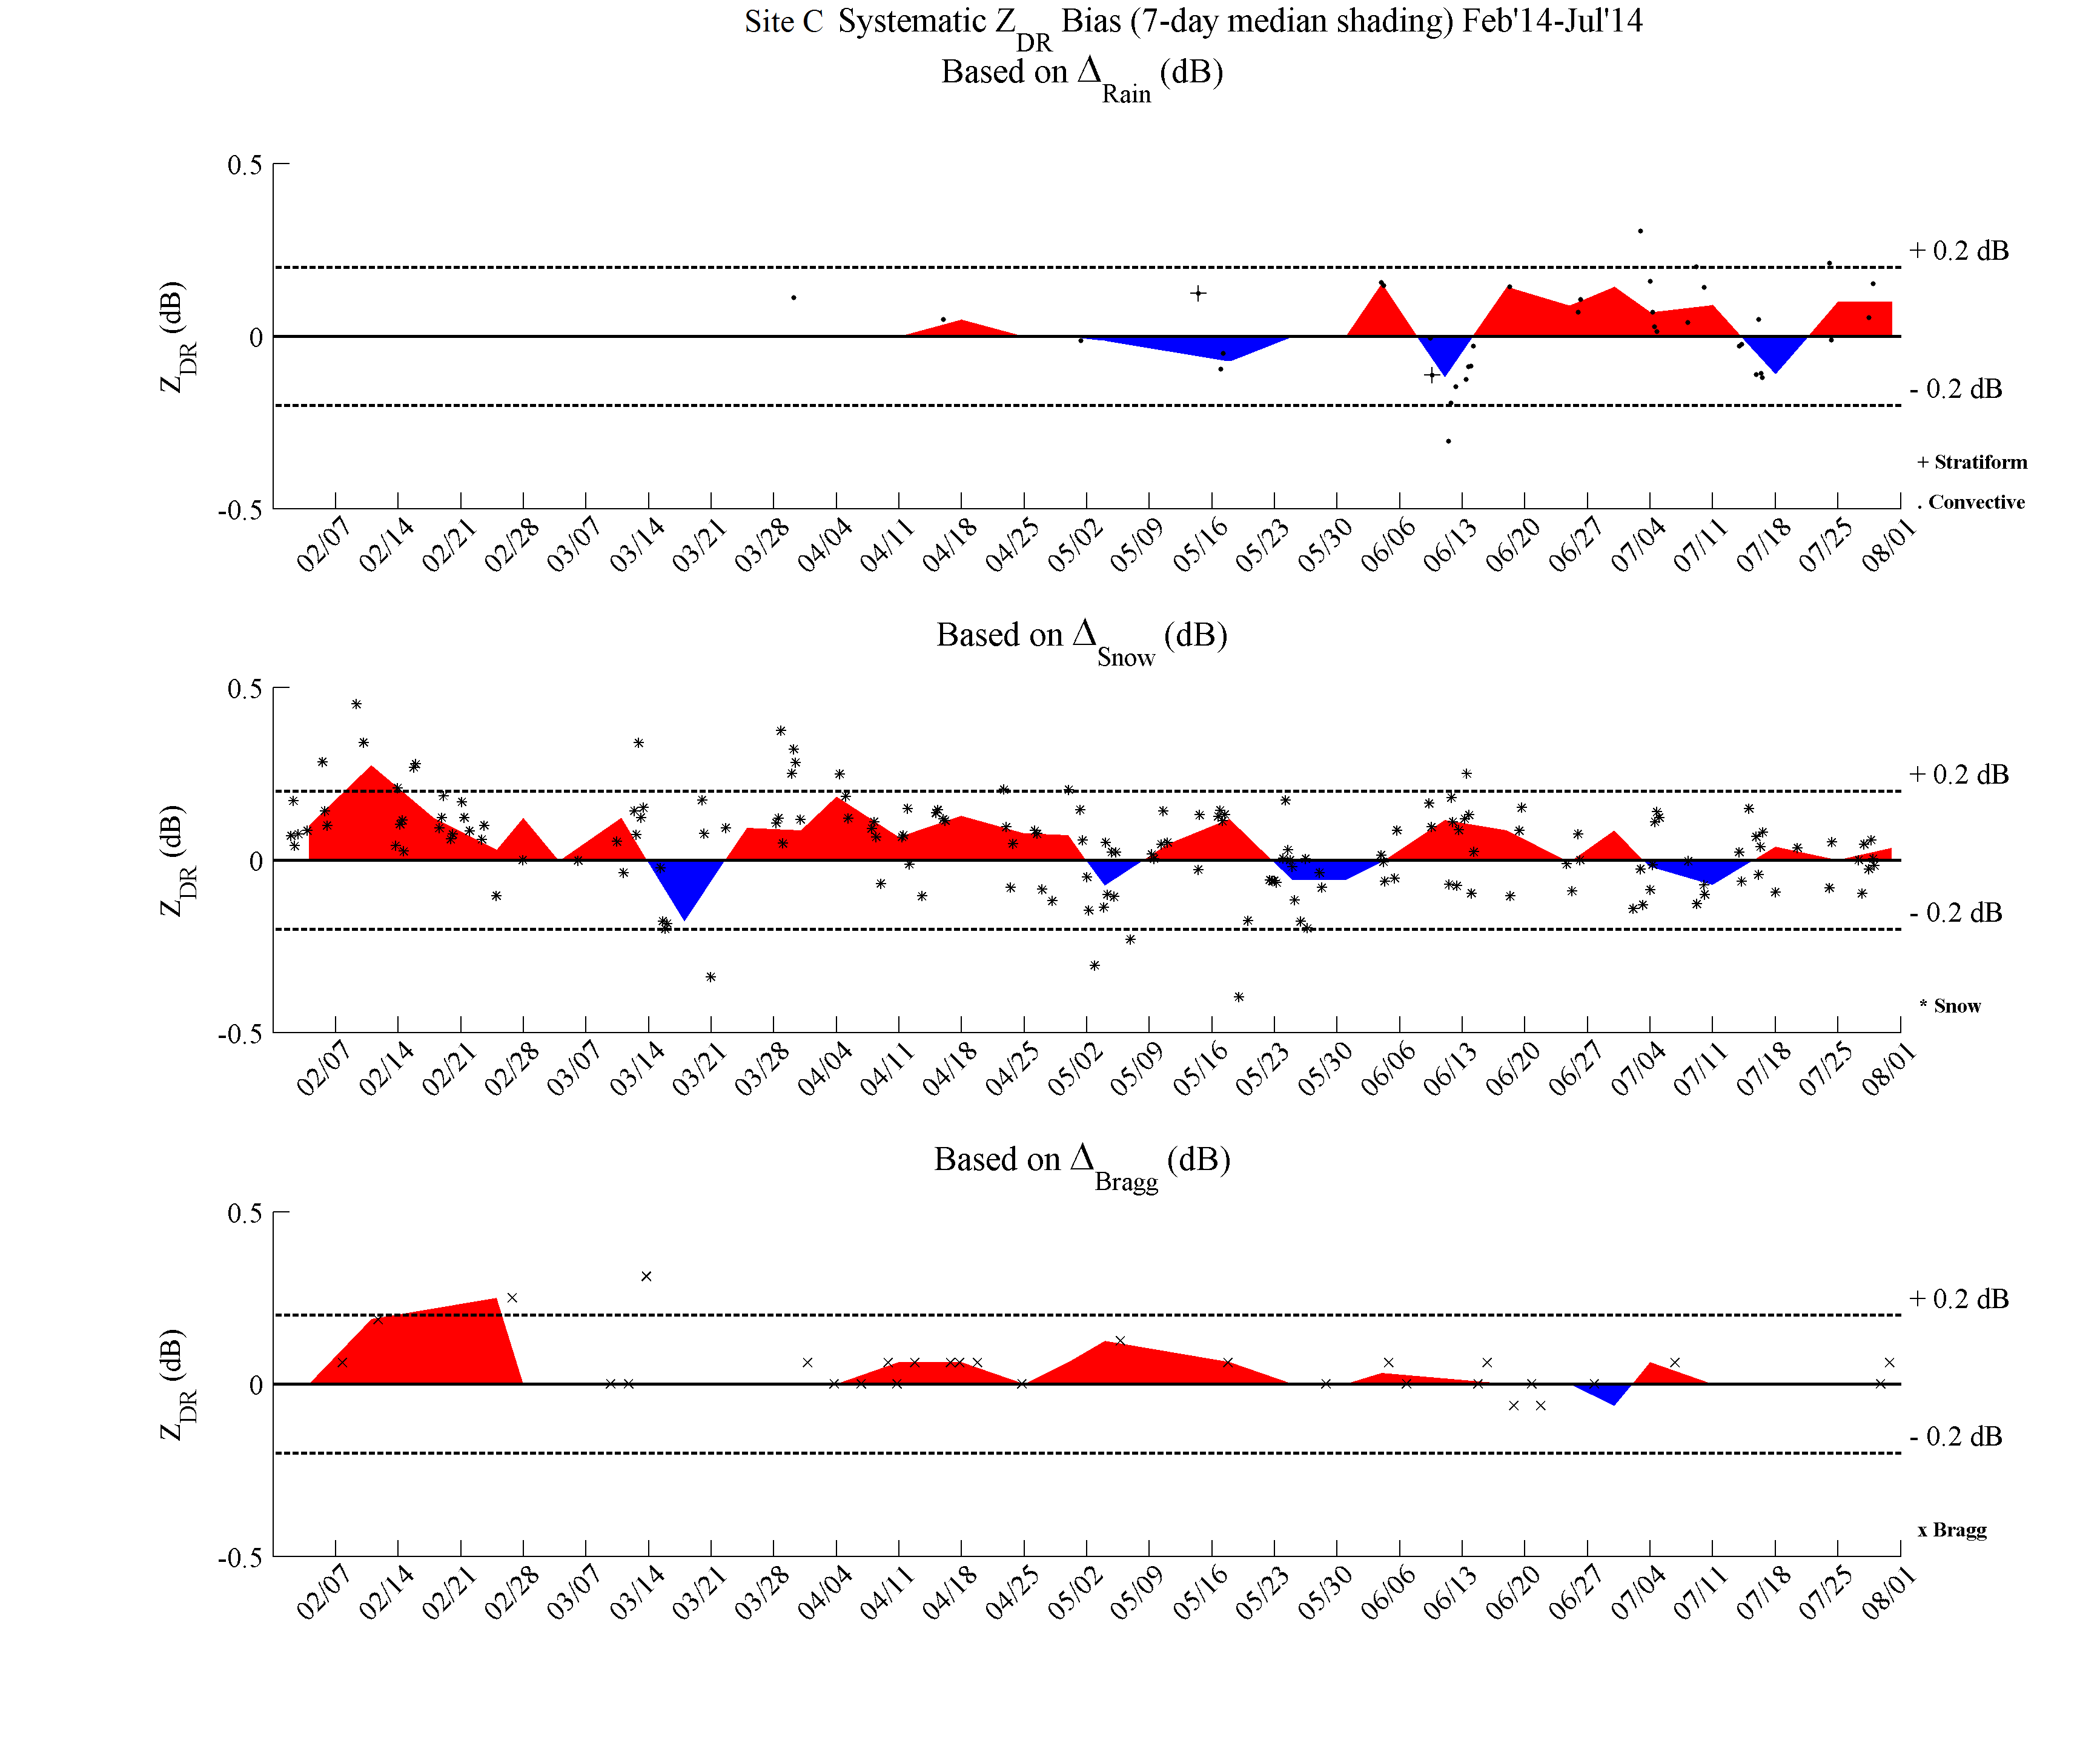
Shade Interpretation: Another “Good” Site
In Tolerance
Alternating red/blue around zero (in tolerance) is OK
Precipitation Contamination Outlier

Slide 32
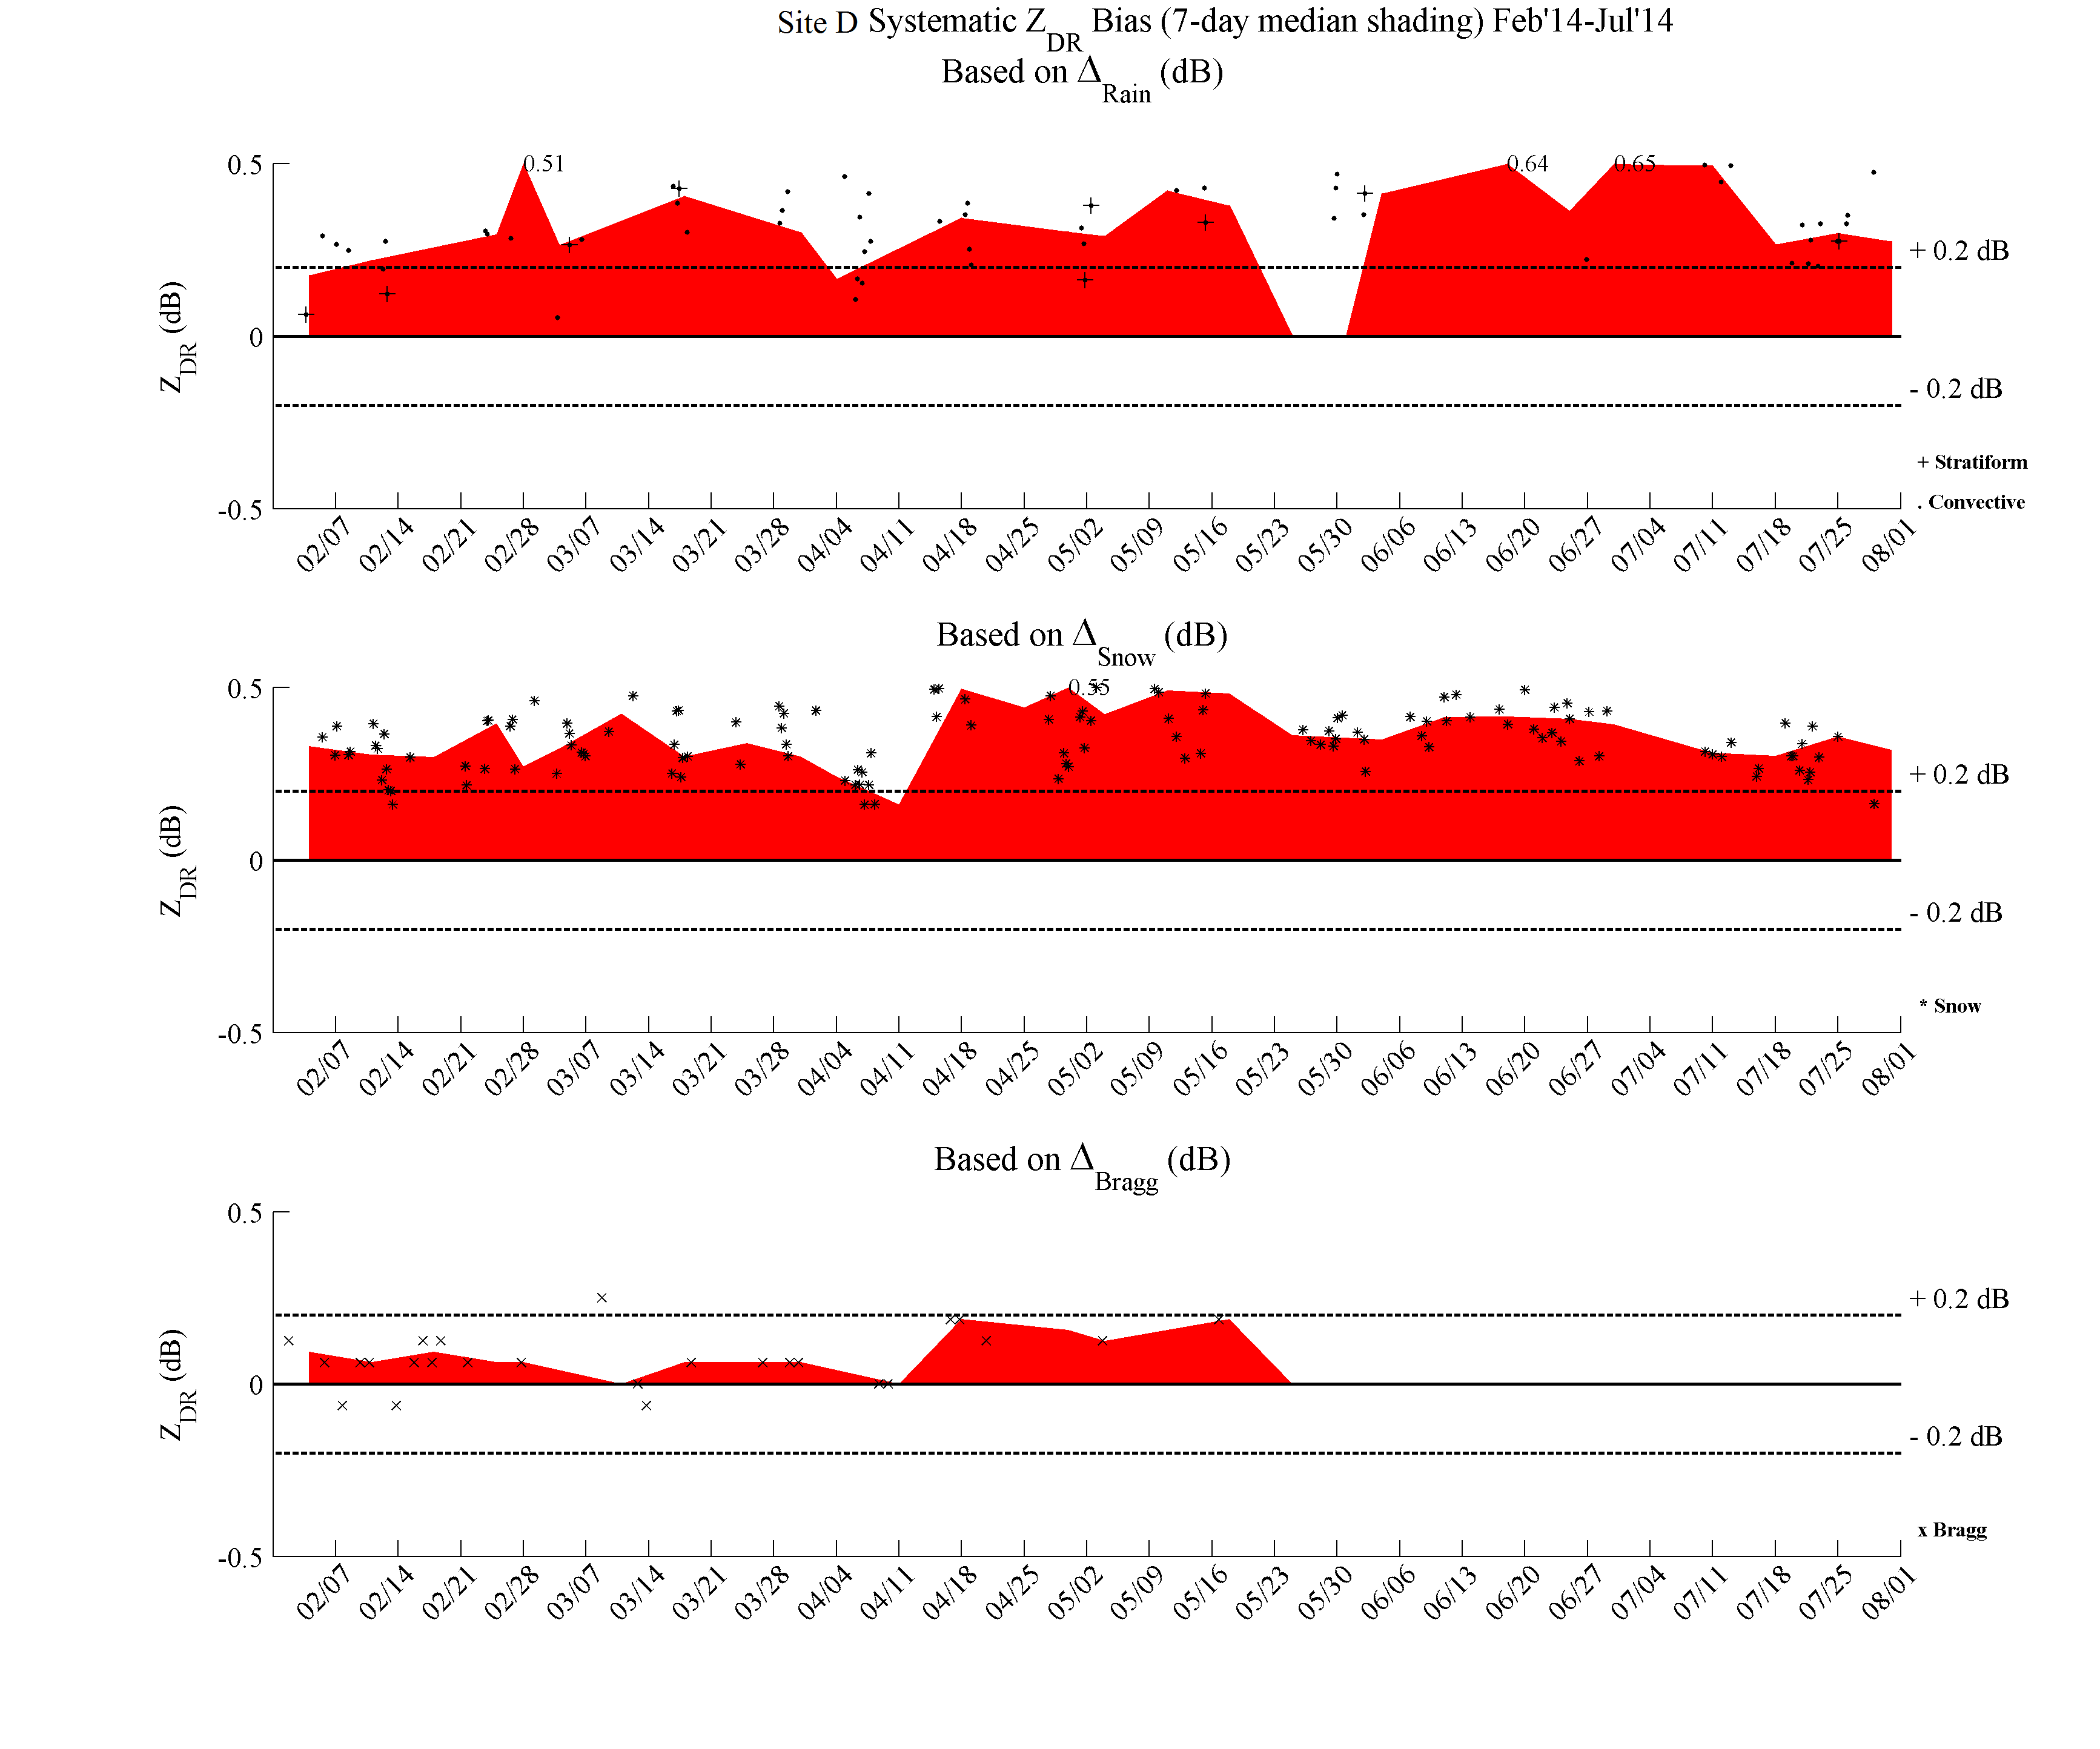
Shade Interpretation: Warm Bias
Out of Tolerance
A warm bias causes QPE underestimation

Slide 33
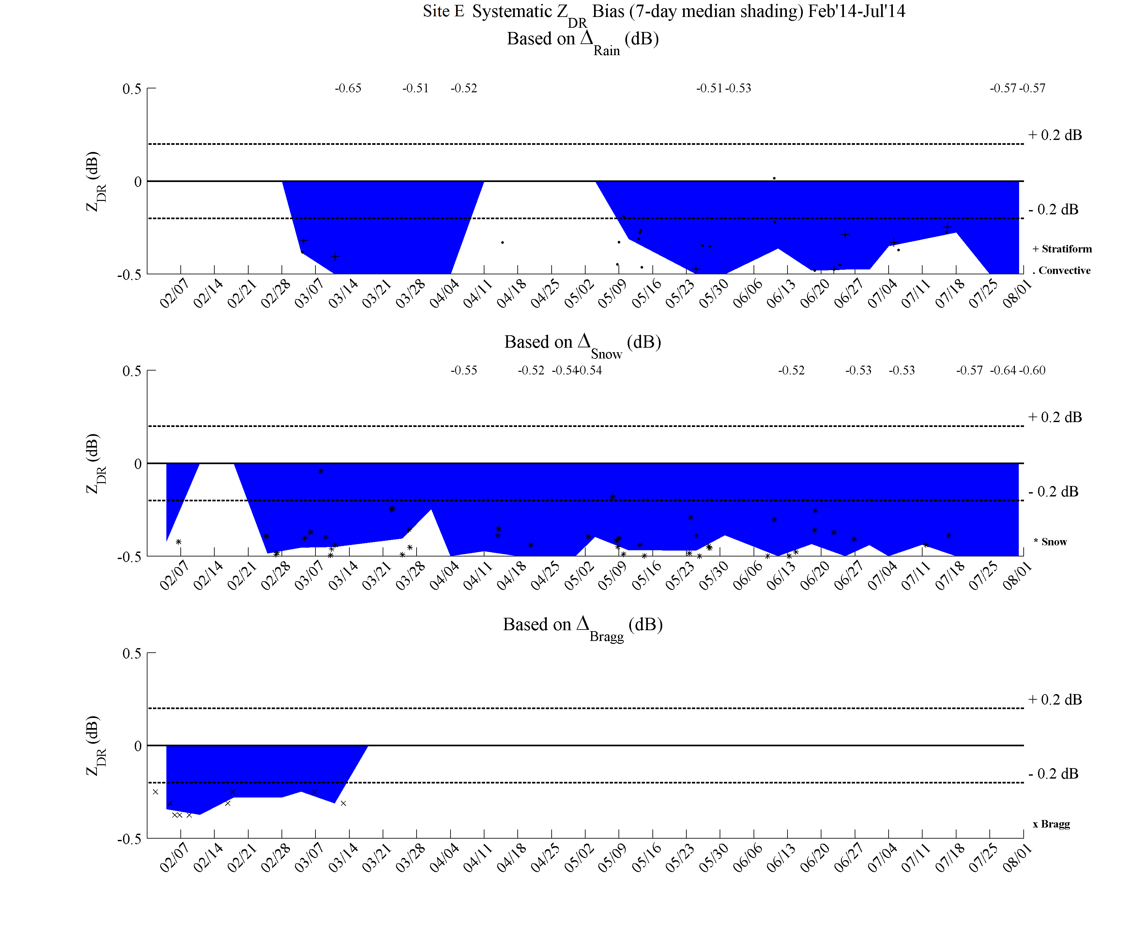
Shade Interpretation: Cold Bias
Out of Tolerance
A cold bias causes QPE overestimation

Slide 34
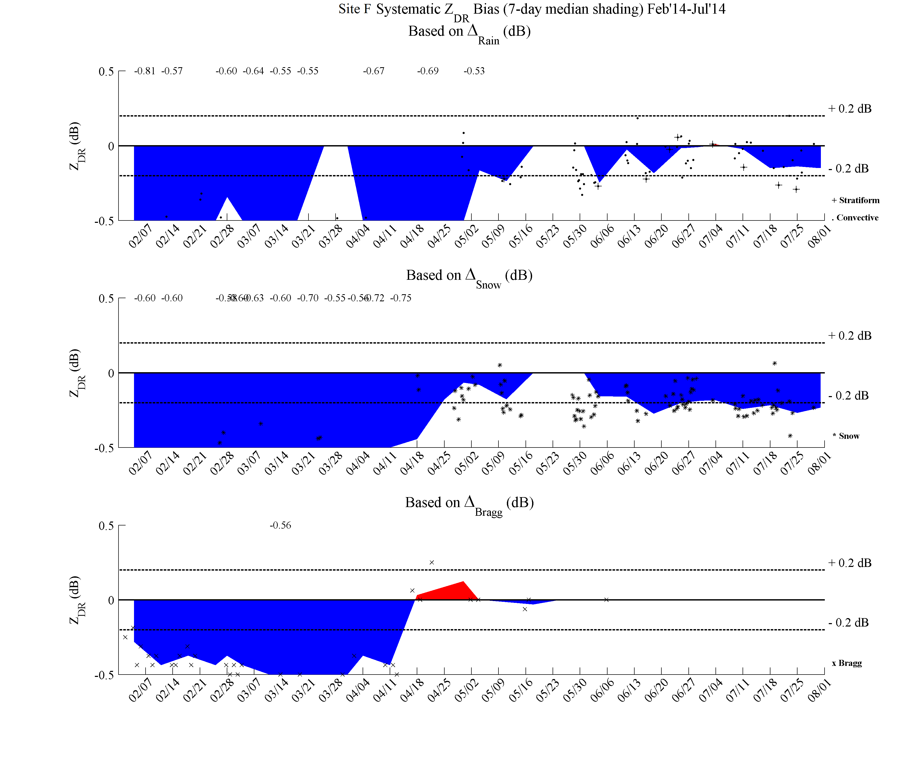
Shade Interpretation: Site Improves
Less Bias – Essentially In Tolerance
Improvement
Site had a large negative bias and improved closer to tolerance
Large Negative Bias
Less Bias – Essentially In Tolerance
Improvement
Large Negative Bias
Less Bias – Essentially In Tolerance
Improvement
Large Negative Bias

Slide 35
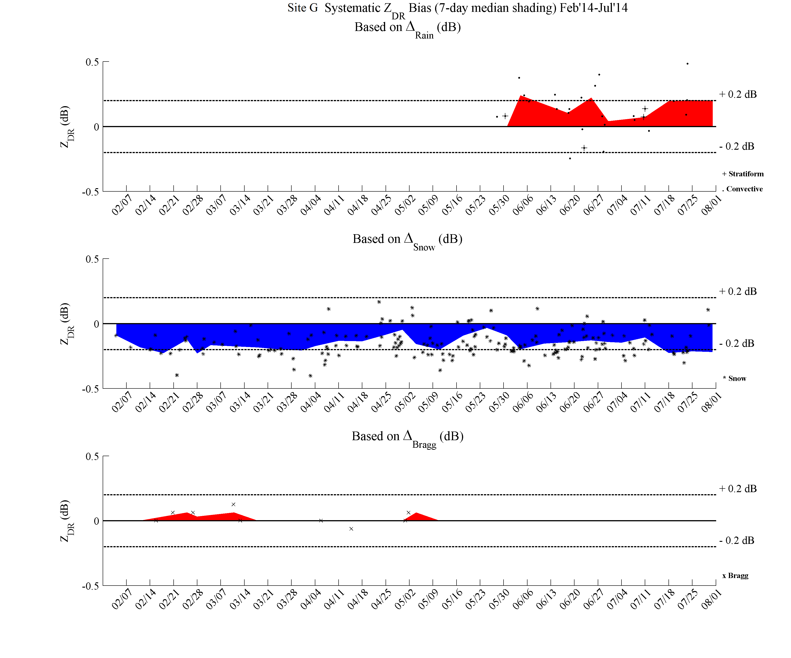
Shade Interpretation: Disagreement
Disagreement possible due to the independent method caveats
Rain can be biased high from larger drops
Site bias is likely around 0.0 dB in this case
Within tolerance on both sides, so less priority to take action
Snow can be biased low from subtraction correction
Bragg was around 0.0 dB, and site doesn’t appear to drastically change over time in other methods

Slide 36
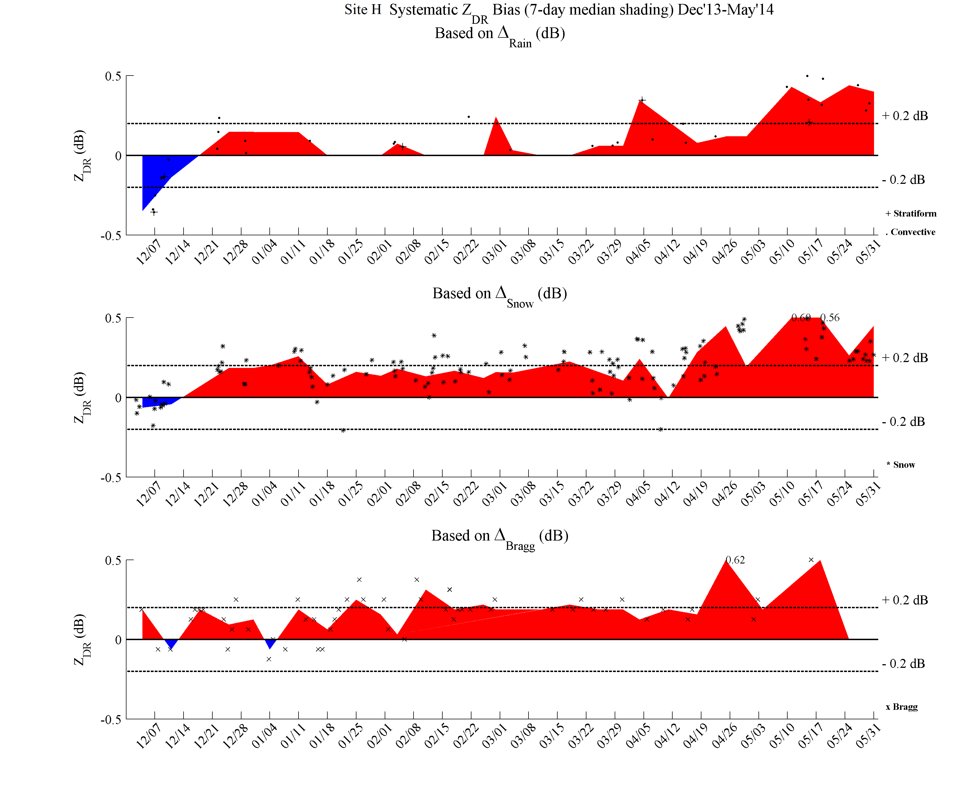
6-Month Time Window
Shading features are consistent for a given month
Site H
End Month: May
Note how the circled areas move with time in the next two slides

Slide 37
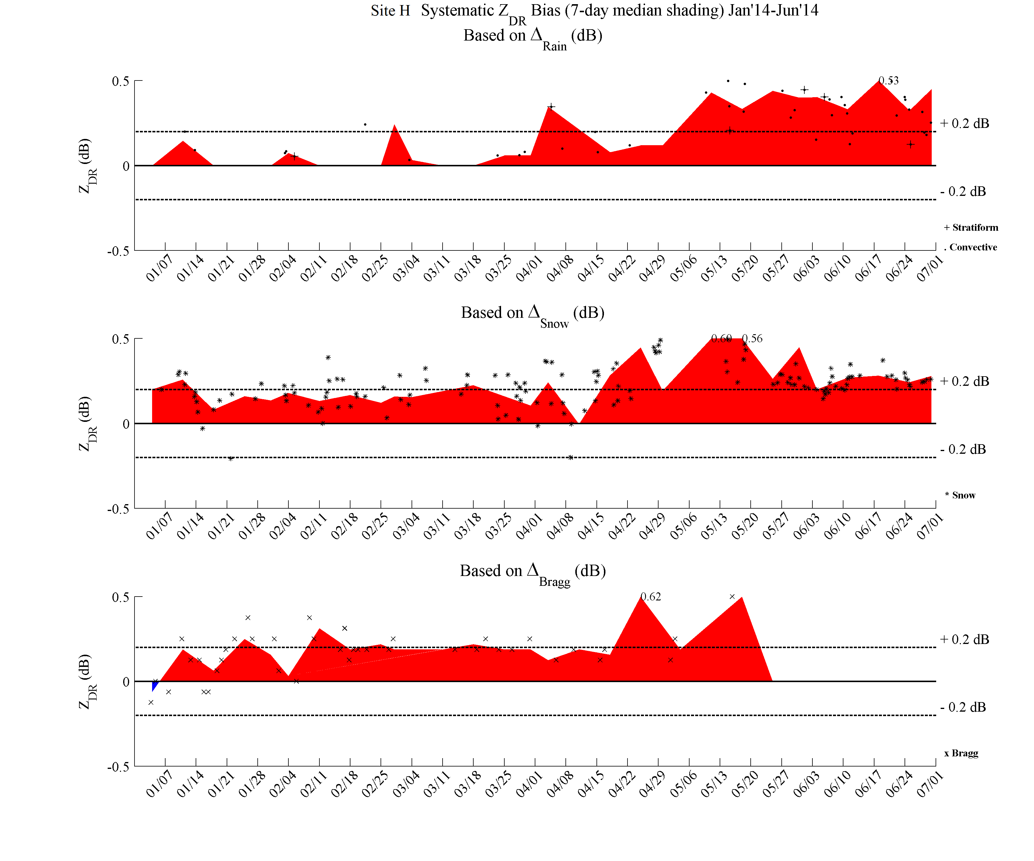
6-Month Time Window
Features move to the left
Site H
End Month: June

Slide 38
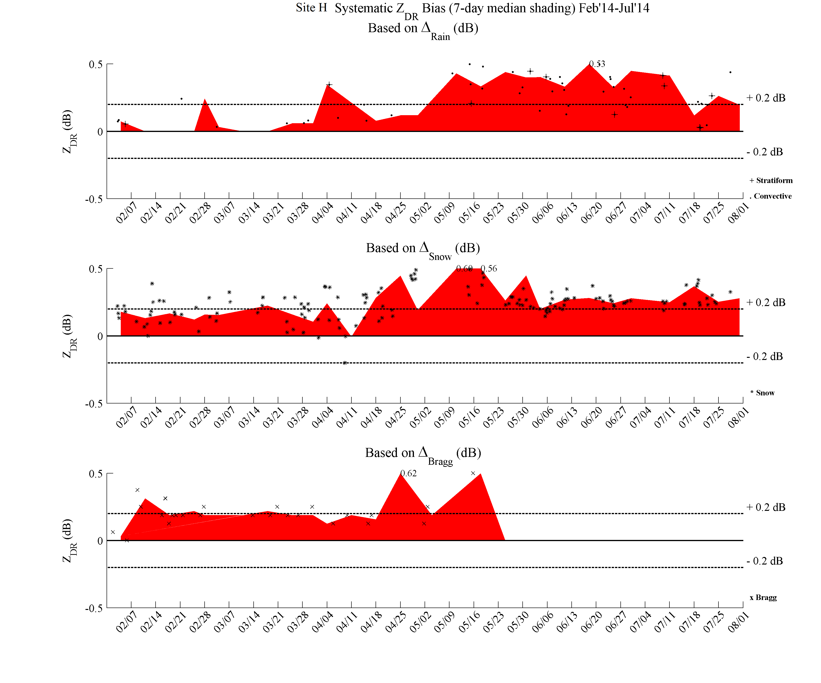
6-Month Time Window
Some features move off with the moving time window
Site H
End Month: July
Previous months are archived and available

Slide 39
Summary
A shade chart is a quick way to assess if a site has a Z_{DR} bias and the approximate magnitude of the bias
  Sites with biases outside of the ±0.2 dB range are considered to be Out-of-Tolerance
  Z_{DR} bias adversely affects several products, especially QPE
Charts can help track when maintenance was performed and if it helped (e.g., had a large bias and was corrected to within tolerance)
  Can also see if a site has a new or drifting hardware issue (e.g., site was in tolerance and jumped to a large bias)

Slide 40
Summary Cont.
We are still exploring the details of the external target methods!
  External targets are an independent, extra metric to the built-in hardware estimates that work with operational scanning strategies and products
  Each method has unique caveats and variability in accuracy
    Some aspects of variability remain unknown
By using multiple methods, there is higher confidence a site does or does not have a bias

Slide 41
Within Tolerance is OK!
Achieving an exact Z_{DR} bias estimates of 0.0 dB can be difficult because the variability of the methods and built-in hardware often exceed ± 0.1 dB
  The trend of median bias estimates falling within ± 0.2 dB should be sufficient for most algorithms and visual analysis

